Slide 1
Algorithm
Lecture #09
Dr.Sohail Aslam

Slide 2
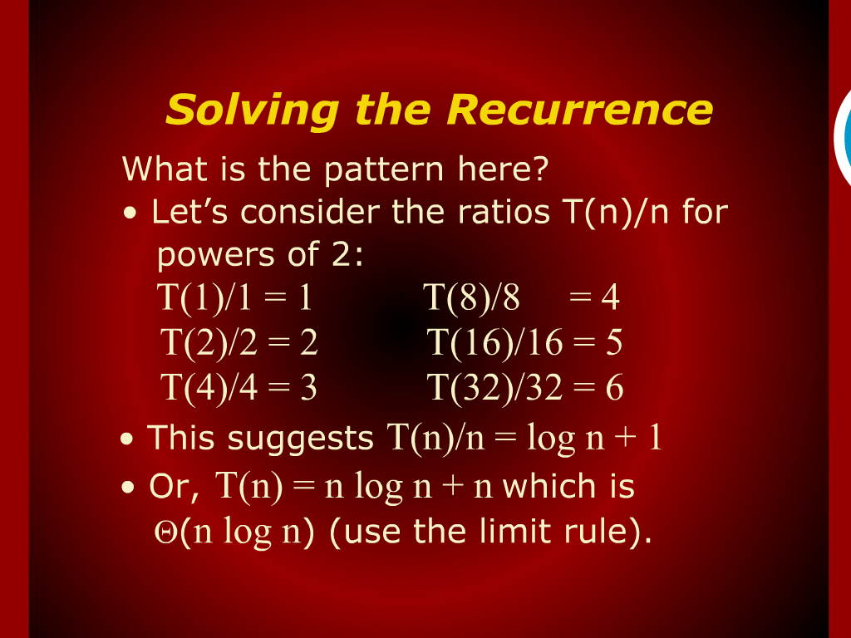
Solving the Recurrence

Slide 3
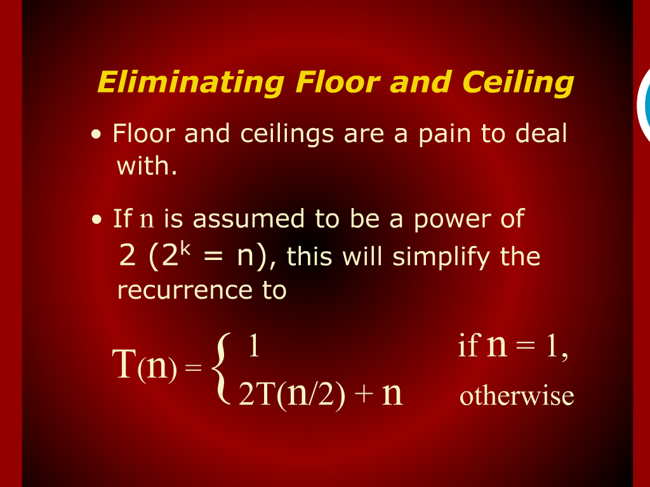
Eliminating Floor and Ceiling

Slide 4
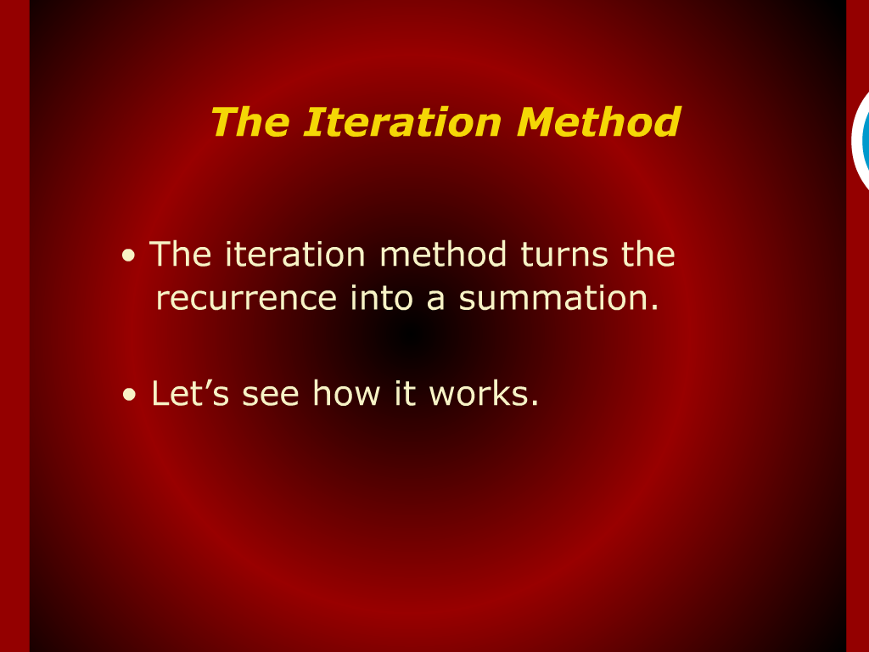
The Iteration Method

Slide 5
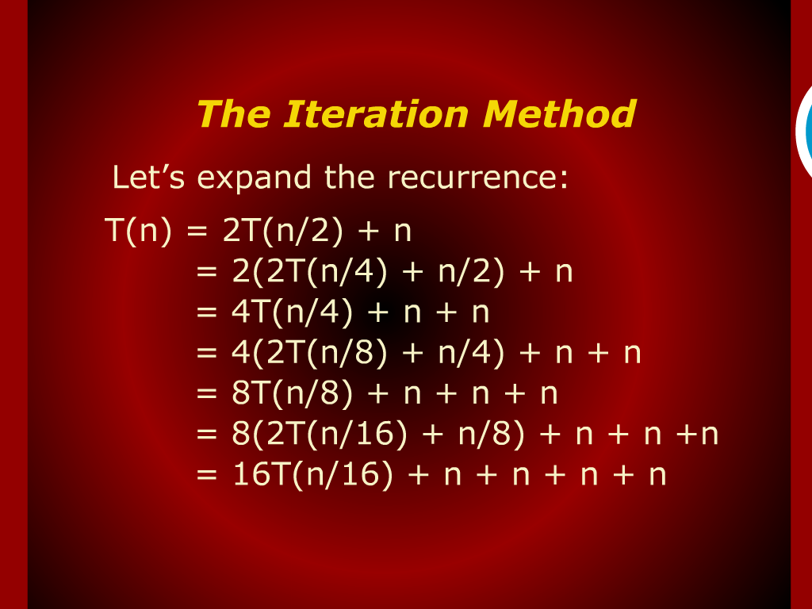
The Iteration Method

Slide 6
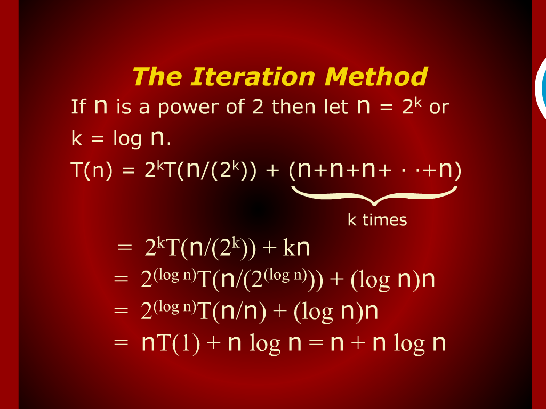
The Iteration Method

Slide 7
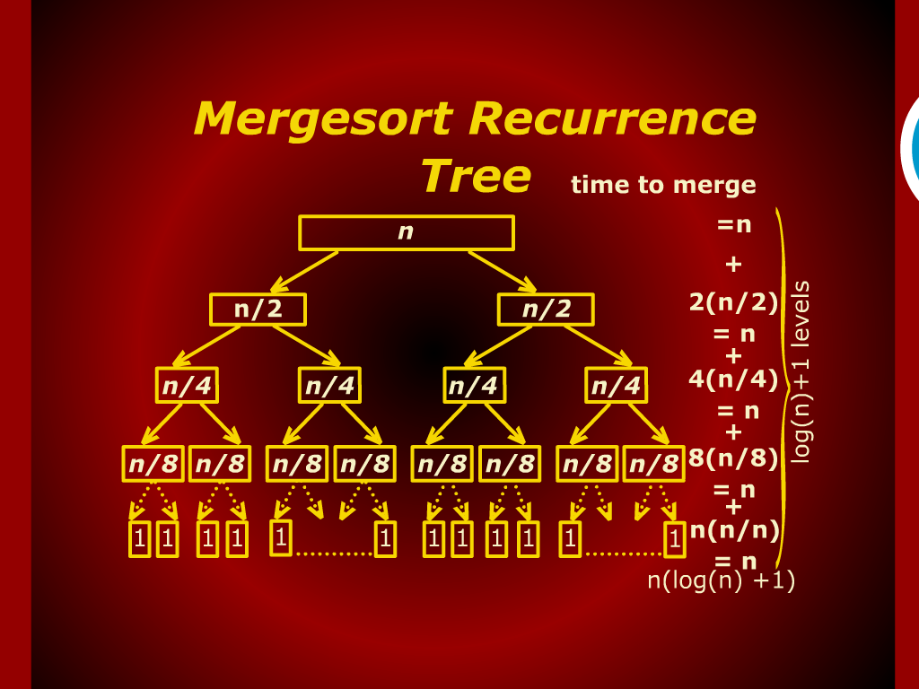
Mergesort Recurrence

Slide 8
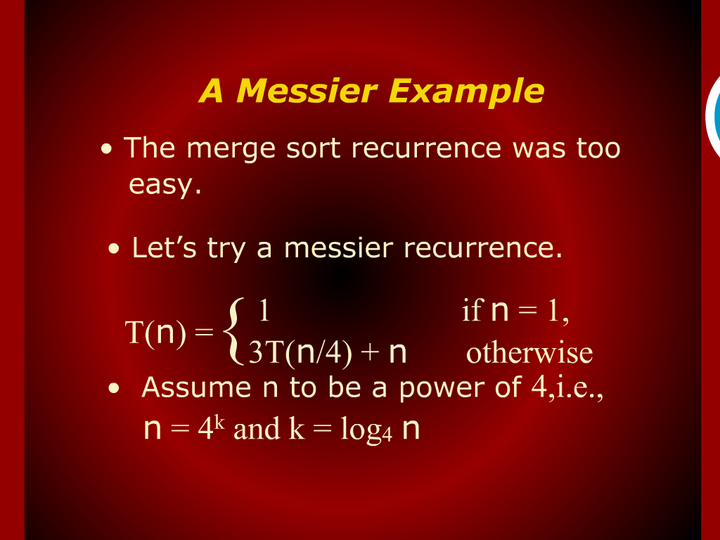
A Messier Example

Slide 9
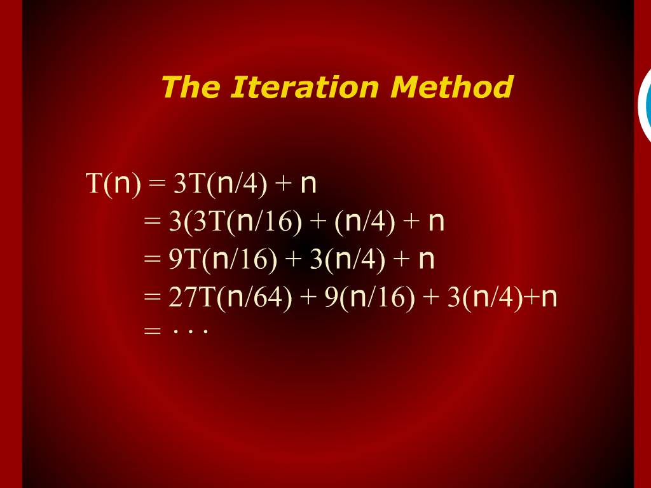
The Iteration Method

Slide 10
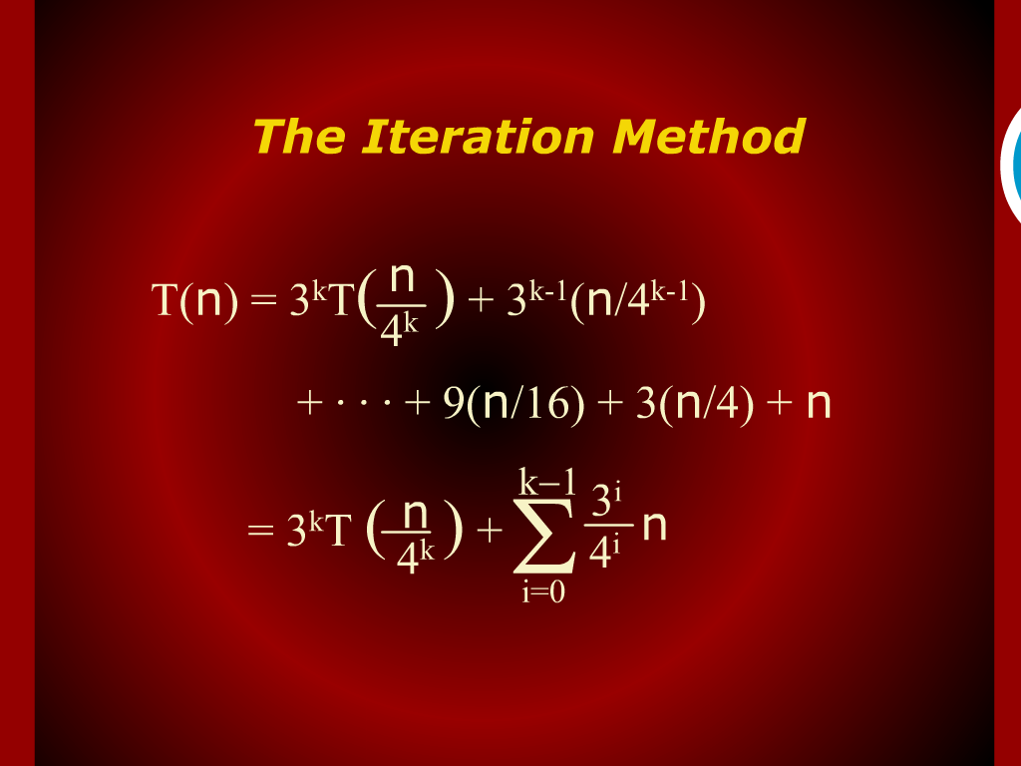
The Iteration Method

Slide 11
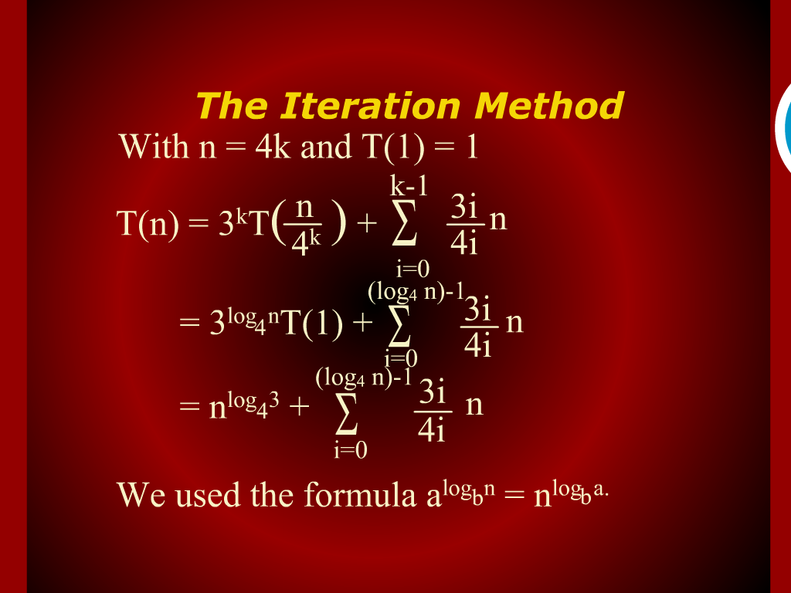
The Iteration Method

Slide 12
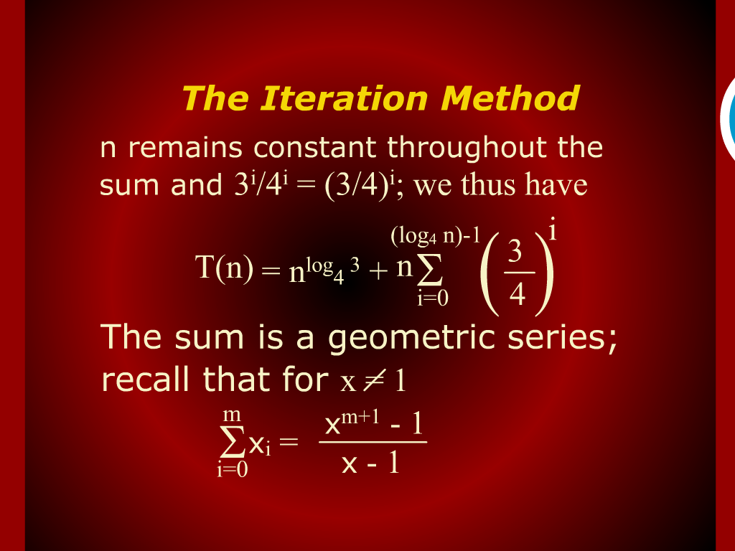
The Iteration Method

Slide 13
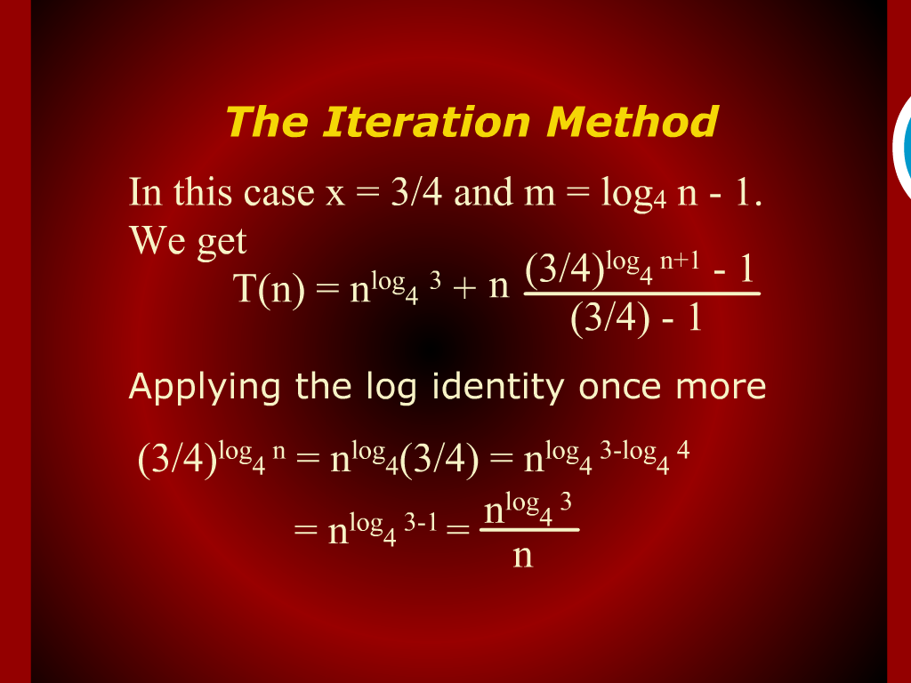
The Iteration Method

Slide 14
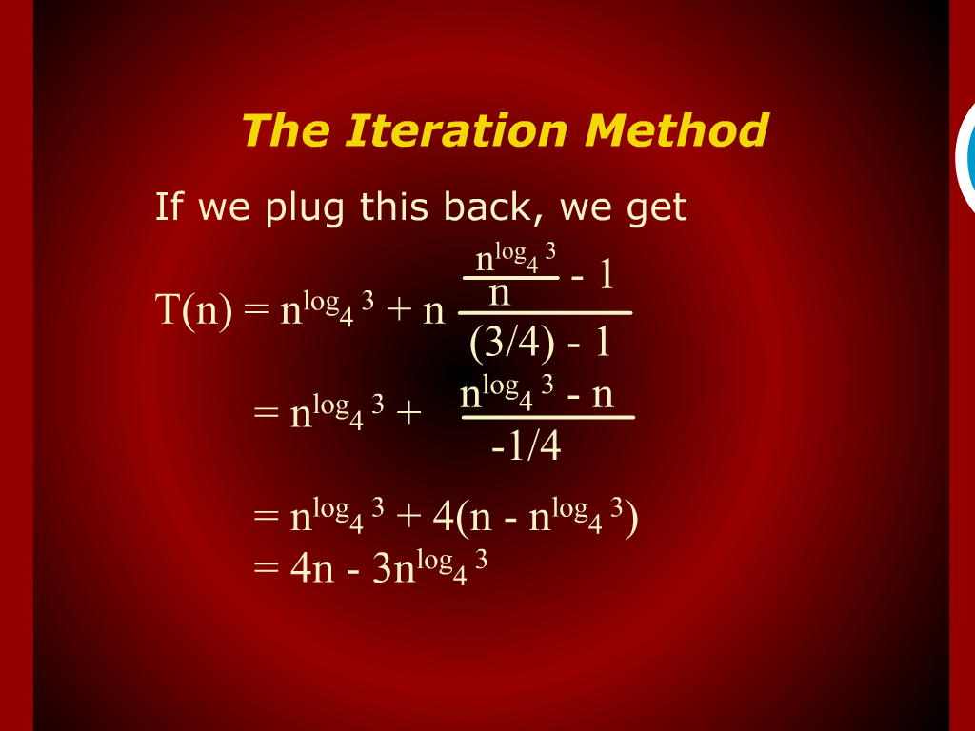
The Iteration Method

Slide 15
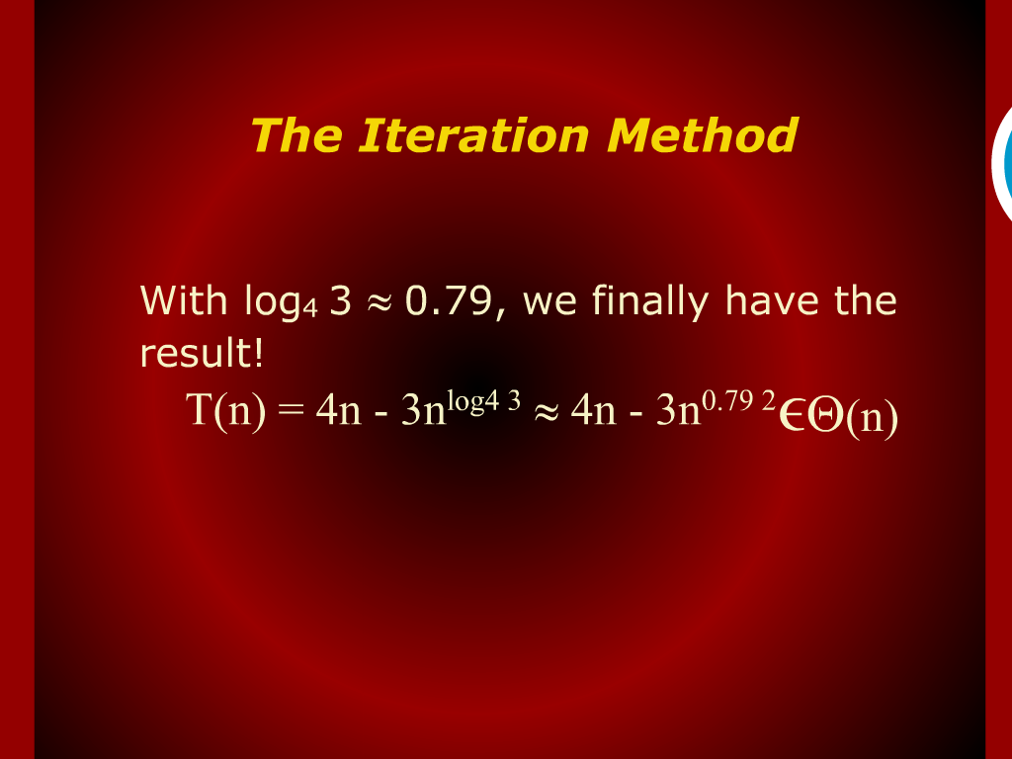
The Iteration Method

Slide 16
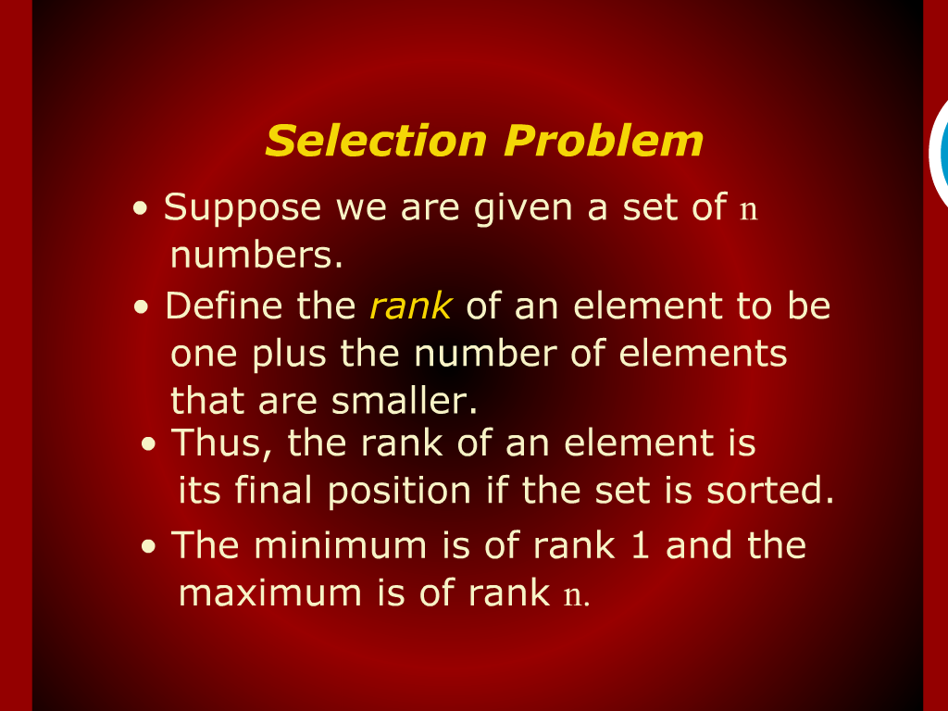
Selection Problem

Slide 17
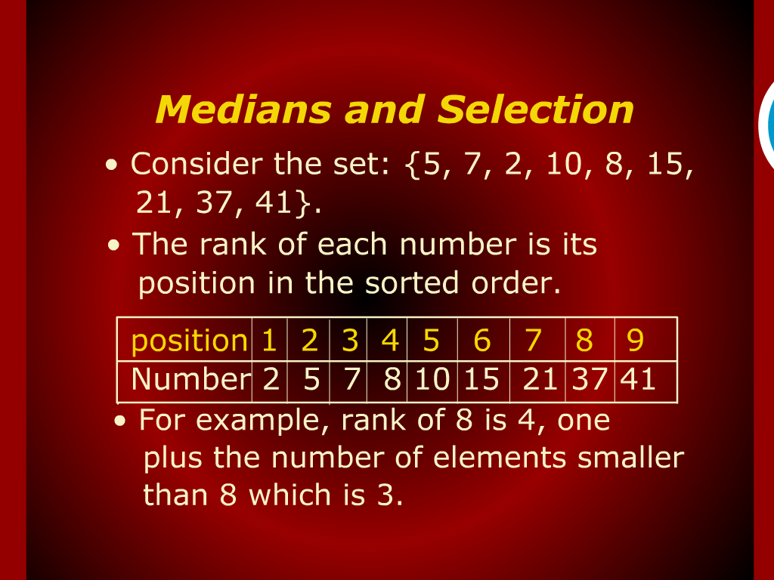
Medians and Selection

Slide 18
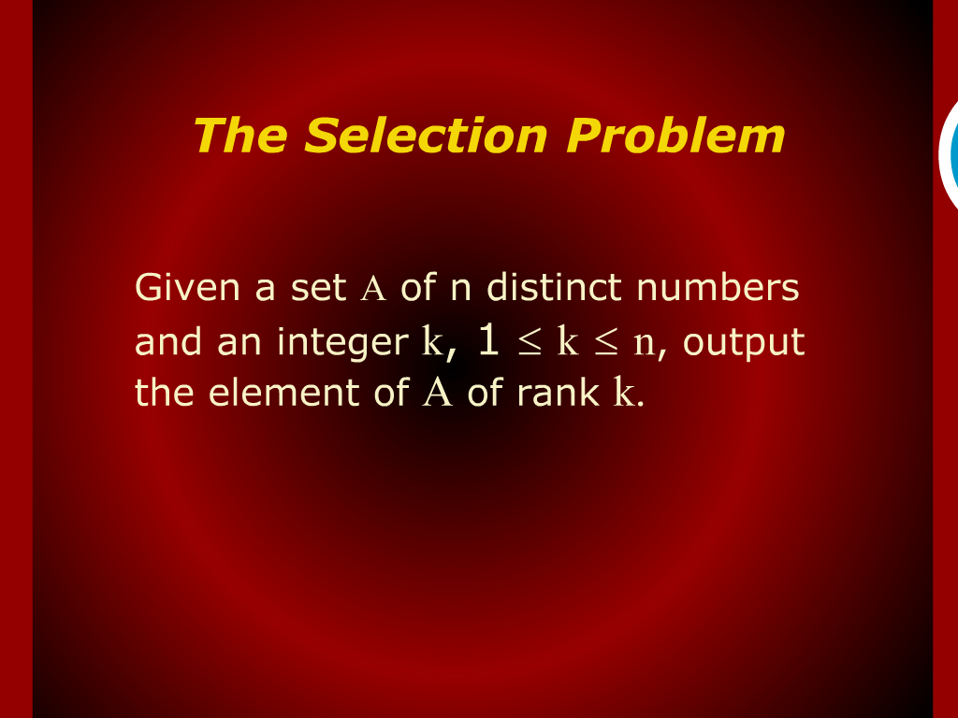
The selection Problem

Slide 19
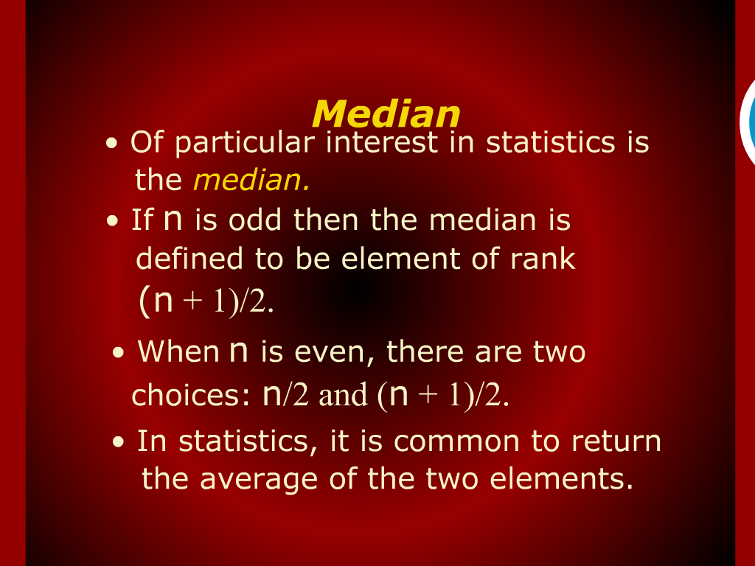
Median

Slide 20
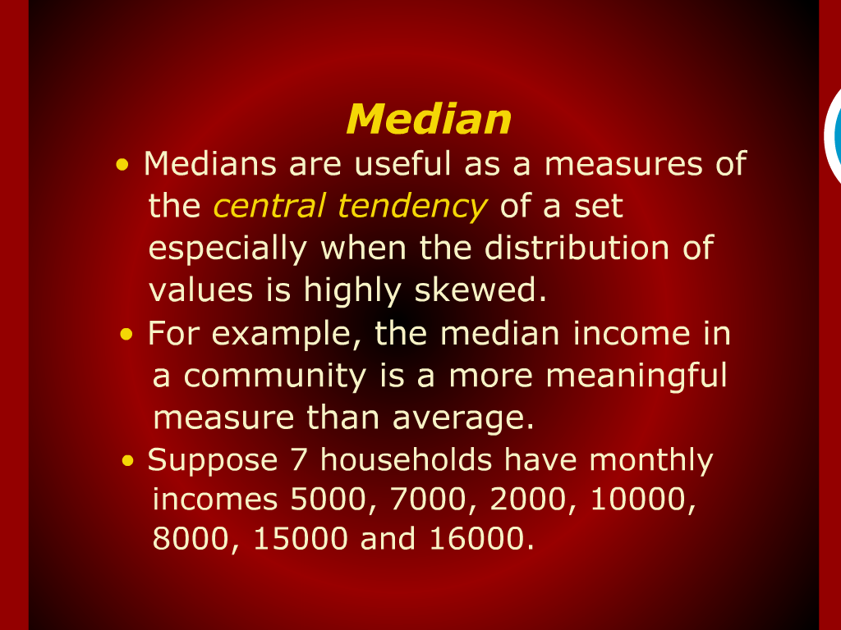
Median

Slide 21
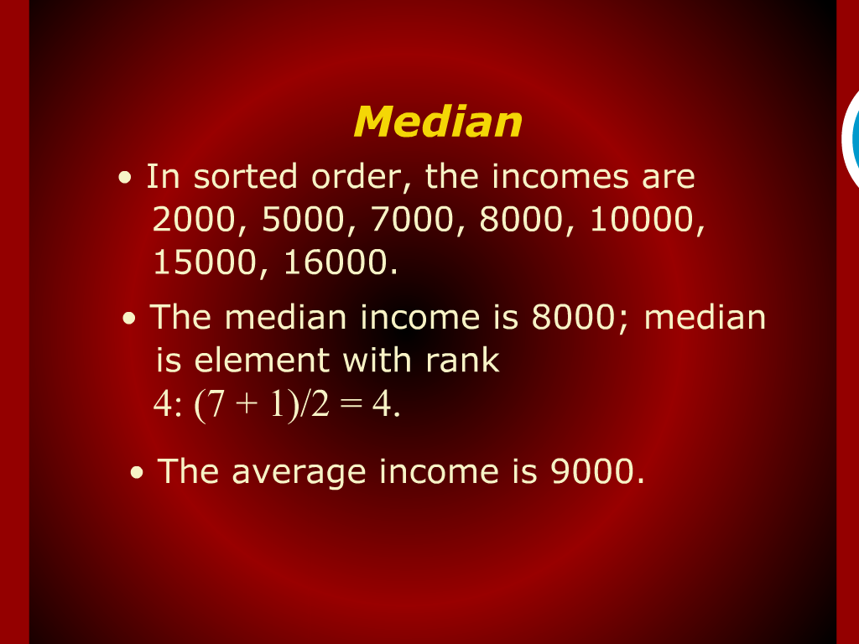
Median

Slide 22
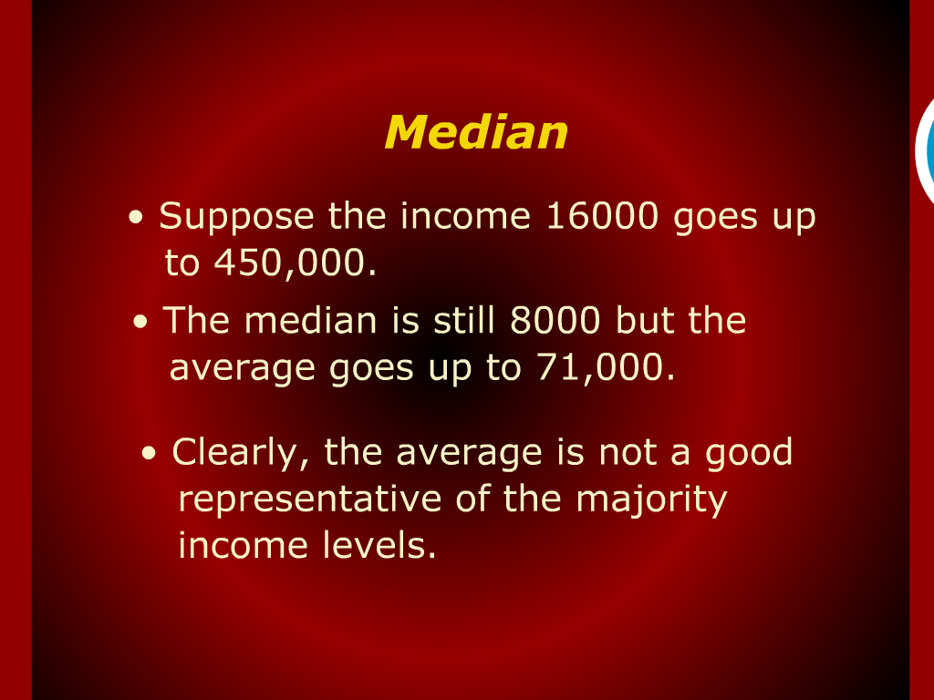
Median

Slide 23
The Iteration Method

Slide 24
Solving the Recurrence

Slide 25
Design
and
Analysis of Algorithm

